Slide 1
Team 6 JobsIndustry Analysis and Visualization
Cossette, Matt, Moua, Chris, xueqing zhao,

Slide 2
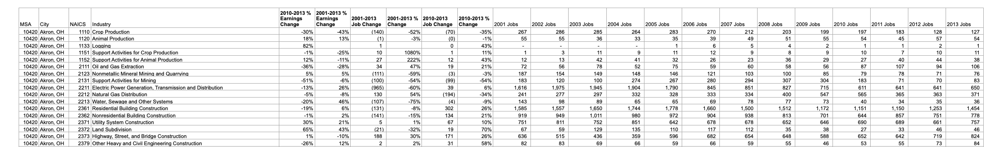
Introduction
1. Data Attributes
MSA: Metropolitan Statistical Area (City)
NAICS: North American Industry Classification System (Industry)
2001 Jobs – 2013 Jobs
2001-2013 Job Change
2001-2013 %Change
2001-2013 %Earnings Change

Slide 3
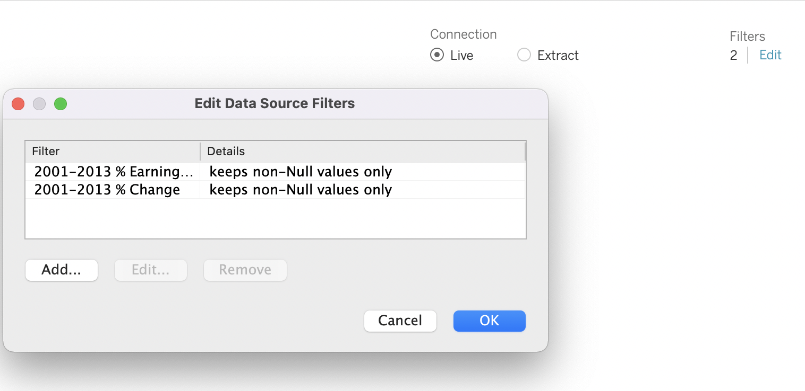
Introduction
2. Missing Data
Some missing values
Missing data points were insignificant to overall visualization
Taking out null values did not significantly affect data
3. Main Story:
Analysis on the overall job changes from 2001-2013 in the United States. We specifically looked at St. Louis, MO from 2001-2013 in the Wired Communications Carriers industry.

